Slide 1
Image Database Architectures
Group 12
By Avinash Akella, Silas Kati, Jason Phadnis, and Raj Vaibhav Gude
Notes:
Group 12

Slide 2
Motivation and Goals
Challenges
Many reasons for wanting fast image lookup
Presentation
Website
All use images to convey some information or message
We want to get images most relevant to our purpose as quickly as possible
What’s favorable
Wish to avoid blind search over database
Query over image metadata instead
Different database structures could affect performance
What’s best when?
Notes:
Our world is filled with a plethora of different things and thus different sights with no two views being exactly the same. As they say, a picture is worth a thousand words. With so many options finding the right image(s) for your purpose could take forever without a way to quickly search them based on what’s in the image.
The design of the database we use to hold images can affect how quickly we get images we’re looking for. We want to find out what designs are best for what sorts of searches. If there is a “best” design to use then we want to know what it is so that we have only the highest performance.
Add learning objectives?

Slide 3
Tools Used
Python
Oracle DB
SQL Developer
Microsoft COCO Dataset
12 supercategories: outdoor, food, indoor, appliance, sports, person, animal, vehicle, furniture, accessory, electronic, and kitchen
80 categories to search on: car, tennis, keyboard, clock, etc.
328K images in dataset
Notes:
Python has some nice libraries that make it easier to work with a database like sqlalchemy.
The groups has some prior experience with Oracle DB making this a good choice.
The COCO dataset already has many annotations associated with each image that can be used to find images with certain things in them. It can even determine how many of the search items are in the images. There is a wide variety of categories to search.

Slide 4
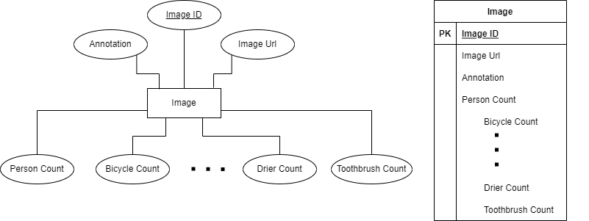
Database Design 1 - Image
Notes:
80 categories. One row per image.

Slide 5
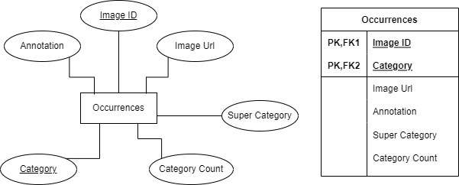
Database Design 2 - Occurrences

Slide 6
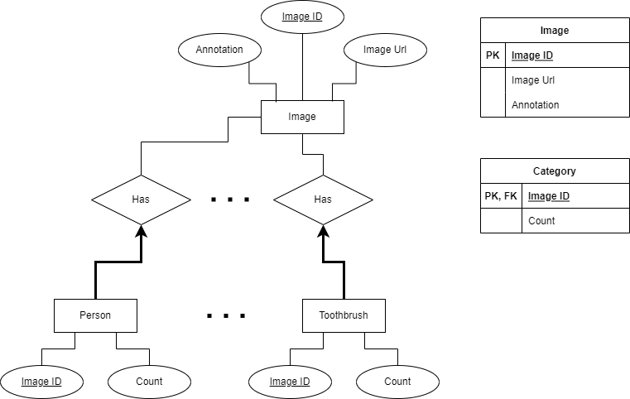
Database Design 3 - Normalized

Slide 7
Data Cleaning and DB Setup
Read in CSV data of images and JSON data of annotations, and categories for those images
Mapped category_id and name of annotations and categories to form category_name as a column
To create a dataset for Image table design
Merged image and annotations info together
Created one-hot representation of each category count
Created occurrences dataset for Occurrences table design (normalized and unnormalized)
Created separate CSV files for datasets in 3 and 4
Dumped them into the Oracle DB using Python
Used Python embedded SQL queries to generate normalized tables
Notes:
We have a python script to do the above.

Slide 8
Experimental Method
Equivalent queries on each database design
100 runs of each query
Indices:
Composite B-tree index on category_name and image_id of Occurrences
Bitmap on category_name of Occurrences
Separate B-tree index on image_id and category_name of Occurrences
Bitmap join between image_id of normalized tables and id of Image table
Notes:
For our experiments, we run an equivalent query on each database design we have. We also run the queries with and without certain indices. We run each query 100 times and record the time it takes each one to complete.
B-tree index on category_name and image_id:
create index occurences_idx on occurences(category_name,image_id)
Bitmap on occurrences:
create bitmap index occurences_idx on occurences(category_name)
B-tree index on image_id column and category_name columns separately:
create index occurences_img_idx on occurences(image_id)
create index occurences_img_idx on occurences(category_name)
Bitmap join for normalized tables and the image table

Slide 9
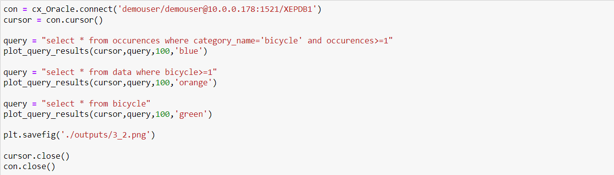
Query 1: Fetch all images with Bicycles

Slide 10
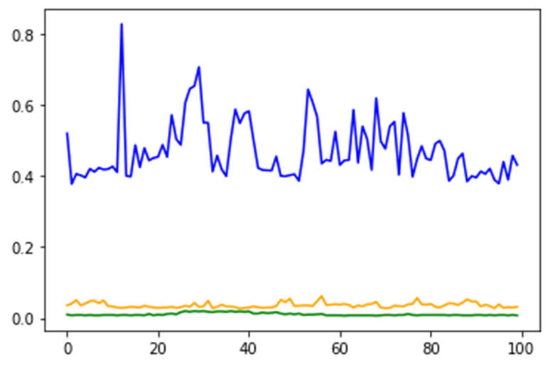
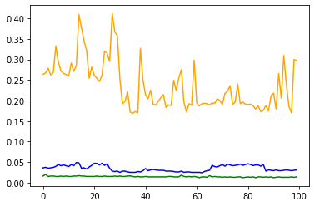
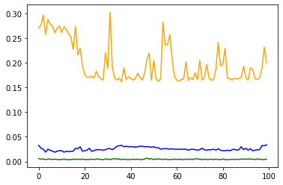
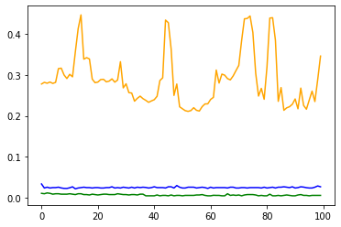
Results: Fetch all images with Bicycles
No Index
B-Tree index
Images Table
Occurrence table
Normalized table
Bitmap Index
B-Tree Separate
Notes:
For all figures, the vertical axis is time in seconds while the horizontal axis is the test number.
If we're querying for a single category, then it's best to use the normalized table as it outperforms the other two in every case. With an index, the unnormalized occurrence table is just slightly worse. The image table has a comparable performance to this when there is no index.
Bitmap join index doesn't help because it's between the normalized and data tables, and we're not querying the normalized tables now.
For all query results, “data” is the table with counts for each category in one row and “occurrences” is the database where each image has a separate entry in the occurrences table for each category.

Slide 11
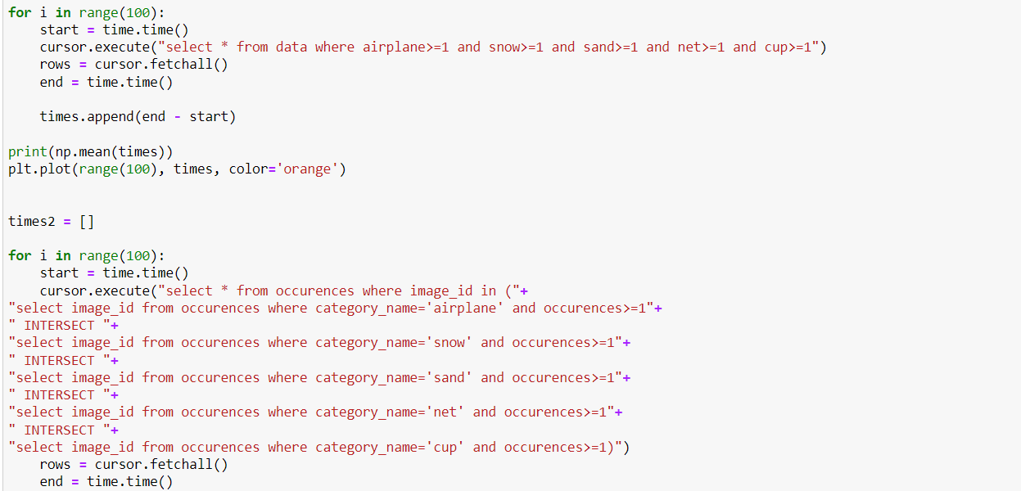
Query 2: Airplane, Snow, Sand, Net, and Cup (Few to None results)
Notes:
Explain the purpose i.e. what is this supposed to test

Slide 12
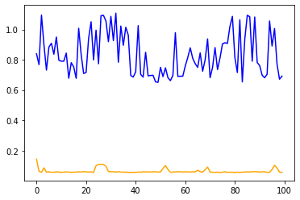
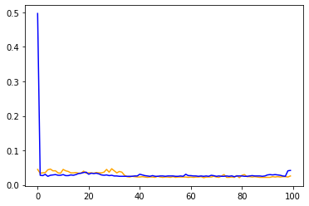
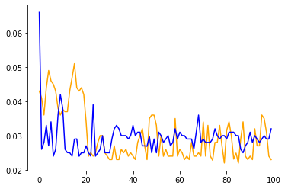
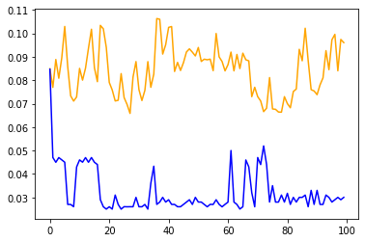
Results: Airplane, Snow, Sand, Net, and Cup
No Index
B-Tree index
Images Table
Occurrence table
Bitmap Index
B-Tree Separate
Notes:
This query has few to none results.
The image table usually performs the best with the separate B-tree index being the main exception.
The B-tree and Bitmap indices improve performance, and the runtimes for both the designs become comparable.
But the separate B-tree index significantly boosts performance. Queries on database with occurrences table outperform those on the image table.

Slide 13
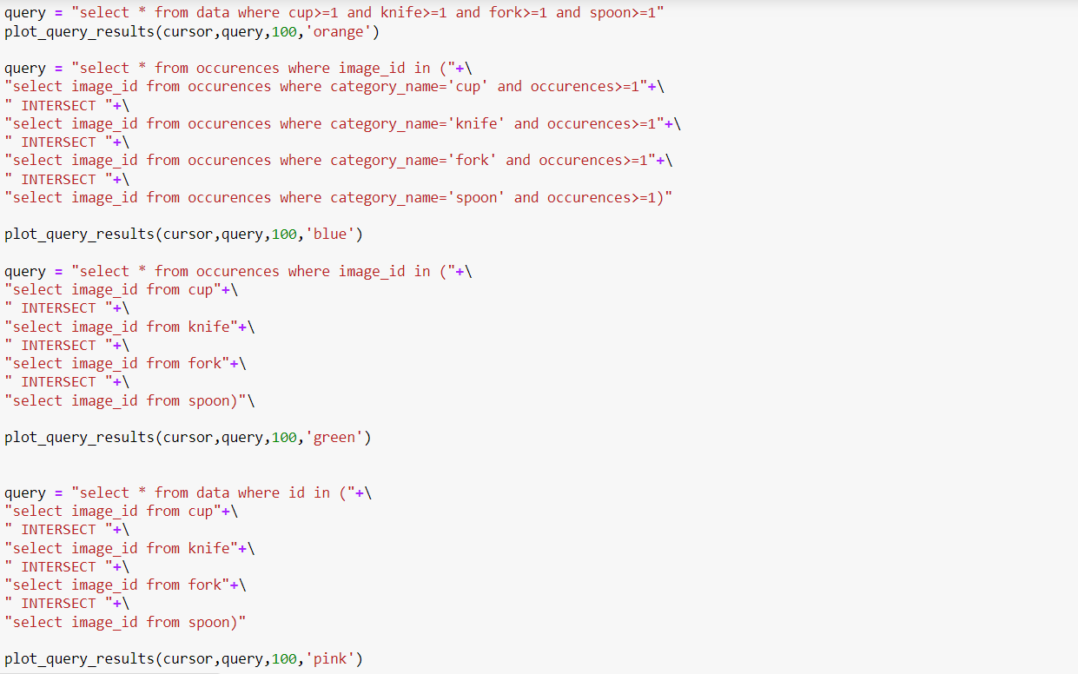
Query 3: Cup, Knife, Fork, and Spoon (Medium sized results)
Notes:
Explain the purpose i.e. what is this supposed to test

Slide 14
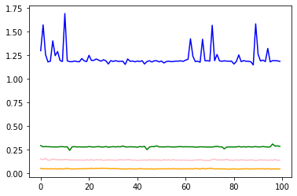
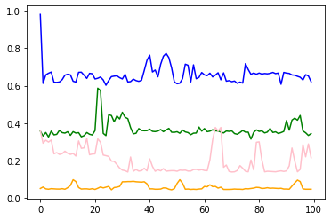
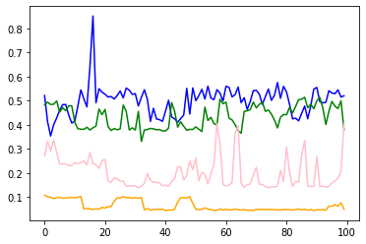
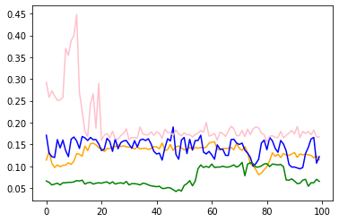
Results: Cup, Knife, Fork, and Spoon
No Index
B-Tree index
Image Table
Occurrence table
Normalized-Occurrence table
Normalized-Image table
Bitmap Index
B-Tree Separate
Notes:
This query yields a medium sized set of results.
The image table performs consistently good, although other tables catch-up with the help of an index.
With the separate B-tree index, the query between normalized-occurrences table (green) outperforms all of the rest. And the query on occurrences is comparable to that on image.
With the bitmap join index, the query between normalized-data table (pink) is as good as, or better, than the query on just the image table.

Slide 15
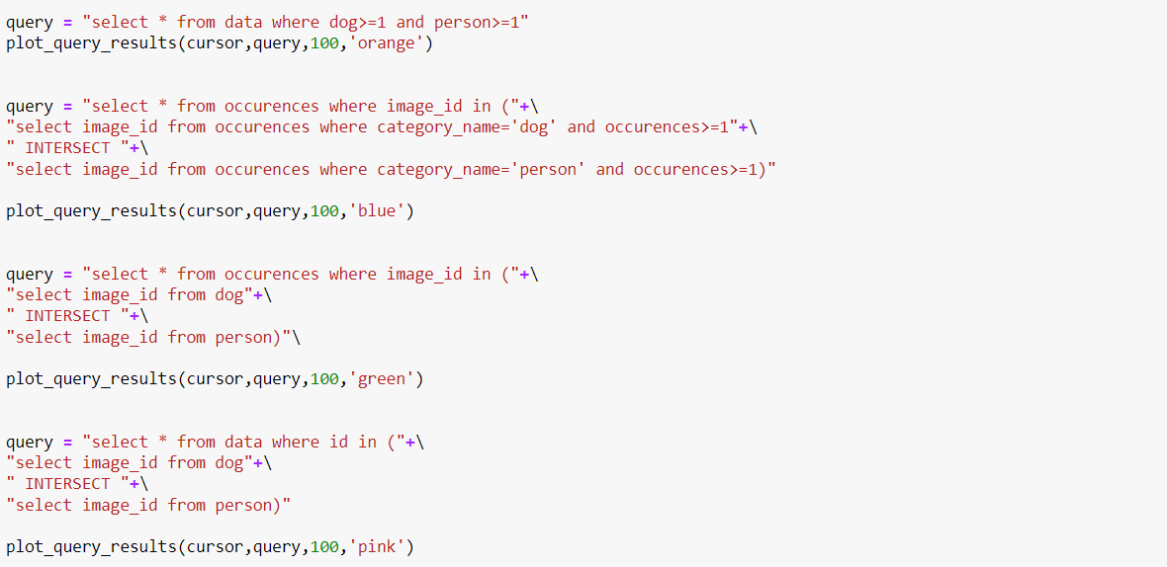
Query 4: Dog AND Person (Large result size)

Slide 16
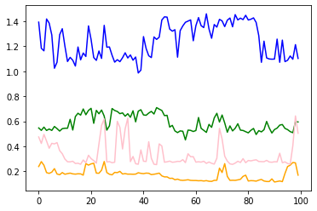
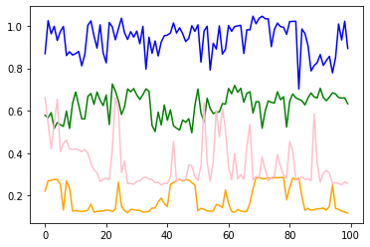
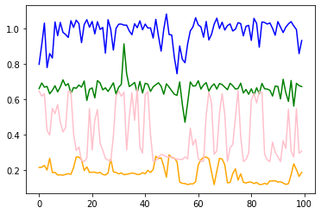
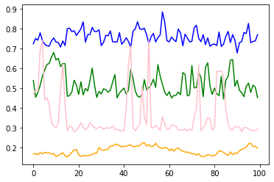
Results: Dog AND Person
No Index
B-Tree index
Image Table
Occurrence table
Normalized-Occurrence table
Normalized-Images table
Bitmap Index
B-Tree Separate
Notes:
This result set is large.
When the result size is large and the # of categories fetched is small, the image table outperforms all of the rest.
Although the separate B-tree index does show an improved runtime.

Slide 17
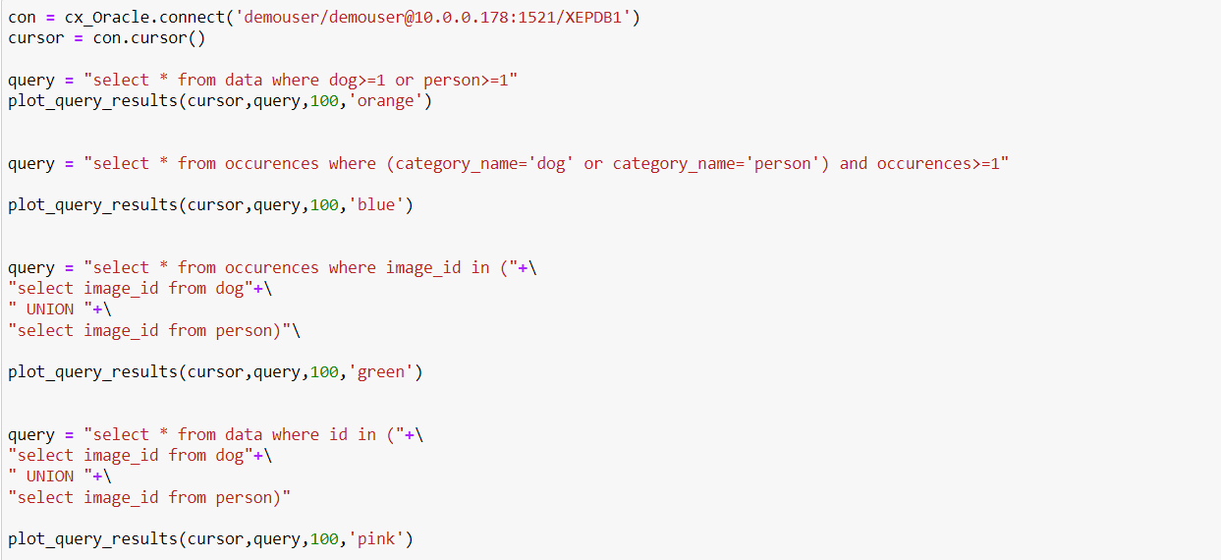
Query 5: Dog OR Person

Slide 18
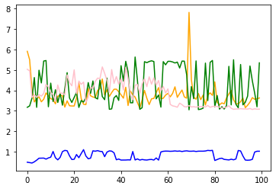
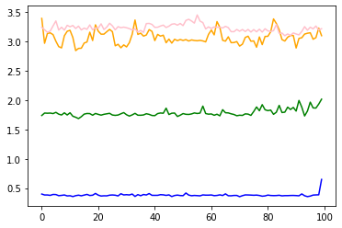
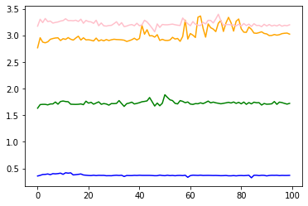
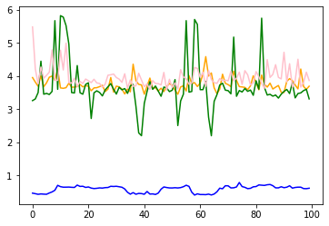
Results: Dog OR Person
No Index
B-Tree index
Image Table
Occurrence table
Normalized-Occurrence table
Normalized-Images table
Bitmap Index
B-Tree Separate
Notes:
This is a surprising result, in that the occurrences table now consistently outperforms all the rest.
This is possibly because the occurrences table is smaller compare to image, and all the other queries involve a join.

Slide 19
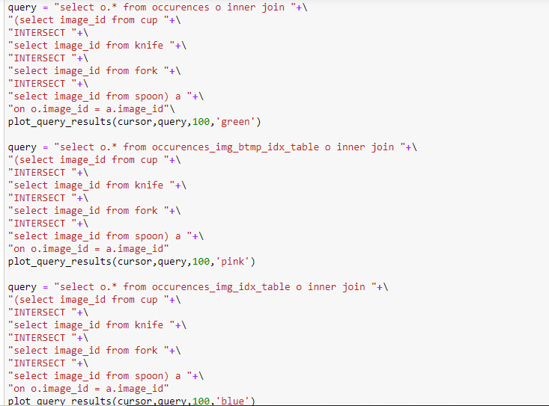
Query 6: Joins

Slide 20
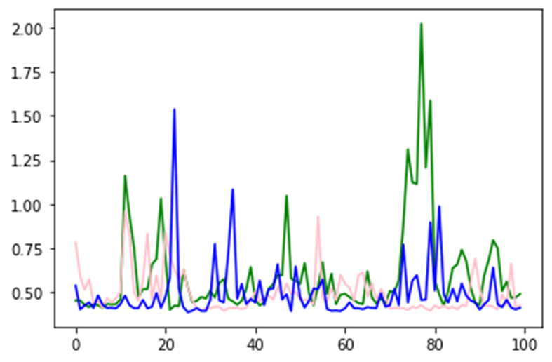
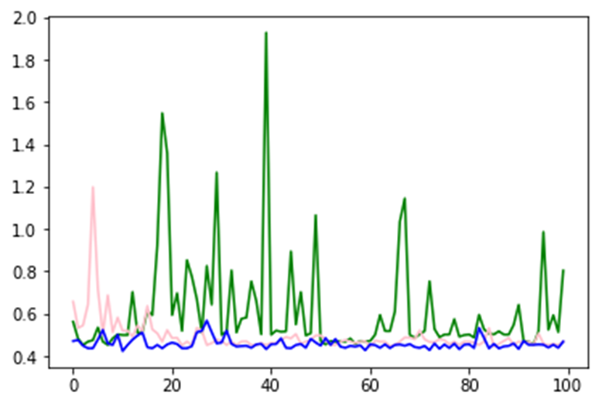
Results: Index on Occurrence table
Join without any indices
Index on Image ID
Index on Category Name and Image ID
Fetching cup, knife, fork, spoon
Fetching spoon
Time taken for Index on Category Name and ImageID: 0.494s
Time taken for BTree on ImageID: 0.490s

Slide 21
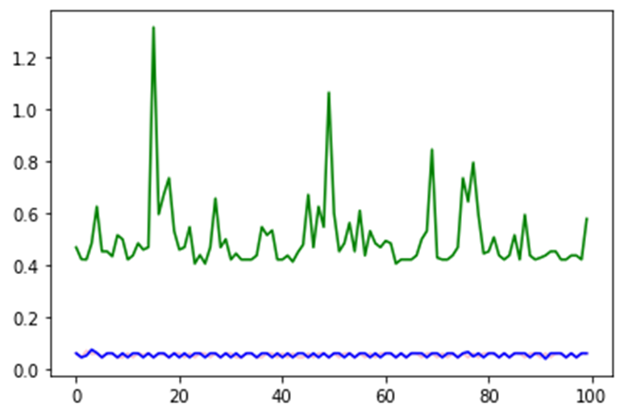
Results: Index on two tables
Join without any indices
Index on Occurrence table
Index on Occurrence and Normalized tables
Fetching cup, knife, fork, spoon
Time taken for BTree on Occurrence: 0.0568s
Time taken for BTree on Occurrence and Normalized table: 0.0562s

Slide 22
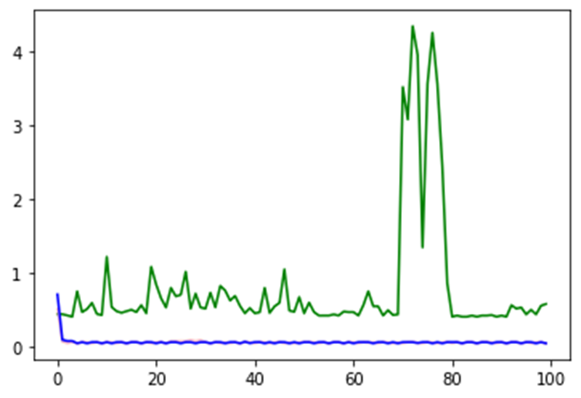
Results: Comparison of Bitmap and BTree Indices
Join without any indices
BTree Index on Occurrence table
Bitmap Index on Occurrence
Fetching cup, knife, fork, spoon
Time taken for BTree on Occurrence: 0.0642s
Time taken for Bitmap on Occurrence: 0.0629s

Slide 23
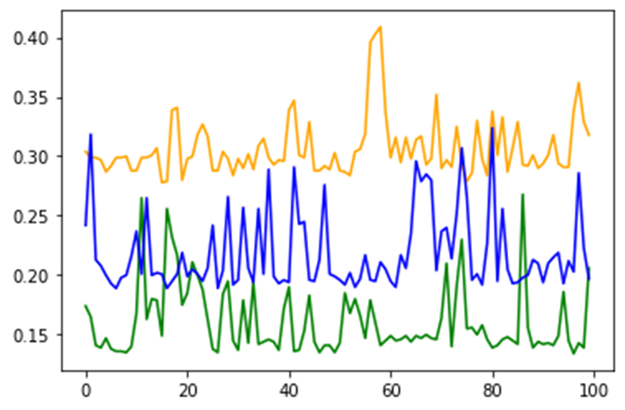
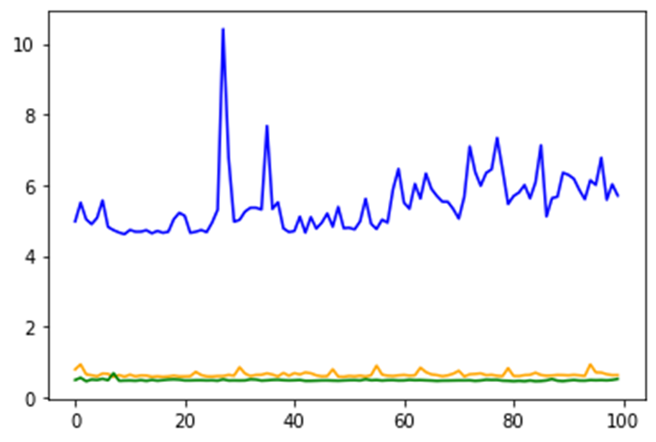
Results: B-Tree join and Bitmap join indices for AND and OR
Join without any indices
Bitmap Index on both tables
B-Tree Index on both tables
Fetching Dog AND Person
Fetching Dog OR Person
B-Tree performs better in both the cases
Bitmap performs worse in the case of OR

Slide 24
Analysis: Queries
When we want only images of one category, a normalized table is the best choice
When we want images with a high number of categories:
Normalized tables along with the Occurrences table with a separate B-tree index on category_name and image_id of Occurrences OR
Bitmap join index between normalized and Images table
For fewer categories Images table performs best
AND vs OR: The Occurrences table significantly outperforms all of the rest for OR queries.
Likely due to its compact nature and absence of any joins.
Notes:
Query based inferences:
For # of categories: single vs rest: When we know there's no overlap of categories, and we're interested in fetching the details of only one of them, a normalized version of the tables is the best choice.
For # of categories: small vs large: When we aim to fetch images containing a large number of categories, using a normalized tables or the occurrences table with a separate B-tree index on category_name and image_id fields of occurrences gives best results. Alternatively, a bitmap join index between a normalized and the data table also helps. On the other hand, for small categories, the data table outperforms all of the rest.
For nature of join: AND vs OR: The occurrences table significantly outperforms all of the rest for OR queries. This is probably because of its compact nature and absence of any joins.

Slide 25
Analysis: Space
Table space:
Images table has large, sparse rows
Normalized tables have creation and maintenance overhead for very little info as number of categories increases
Occurrences table is a good compromise
Index space:
Bitmap and bitmap join useful for low-cardinality columns
B-trees work well for cardinality > 200
Notes:
Space based inferences:
For table spaces: small vs large: The Data table can take up a lot of space as it can be quite sparse. The normalized tables can have the overhead of creating and maintaining a new table for very little info, especially when the number of categories is large. The occurrences table provides better structure and is a good compromise.
For index spaces: small vs large: Bitmap and Bitmap-join indexes are useful for low-cardinality columns. For columns with high-cardinality they have a lot of sparsity and waste space. In theory, B-trees should perform worse for columns with cardinality less than 200, but in practice they work just fine in our case.

Slide 26
Analysis: Multi-domain Data
Normalized vs unnormalized
Normalized is useful when each category has different metadata
Both single and occurrence tables can be hit by sparsity
Notes:
Observation for multi-domain data:
Normalized vs Unnormalized: The normalized version is especially useful in such cases as each category can have different metadata. Both the Data and Occurrences tables can be hit by sparsity here.

Slide 27
Future Work
Look for more scalable architectures. Compare performance in a distributed setting.
Implement and improve the image segmentation/object detection algorithm to get better metadata.
Gather more metadata that can help with search.
Explore methods for similarity search:
Store Hash value of images and create b-tree index on it.

Slide 28
References
https://cocodataset.org/#overview

